Slide 1


IPL AUCTION

Slide 2

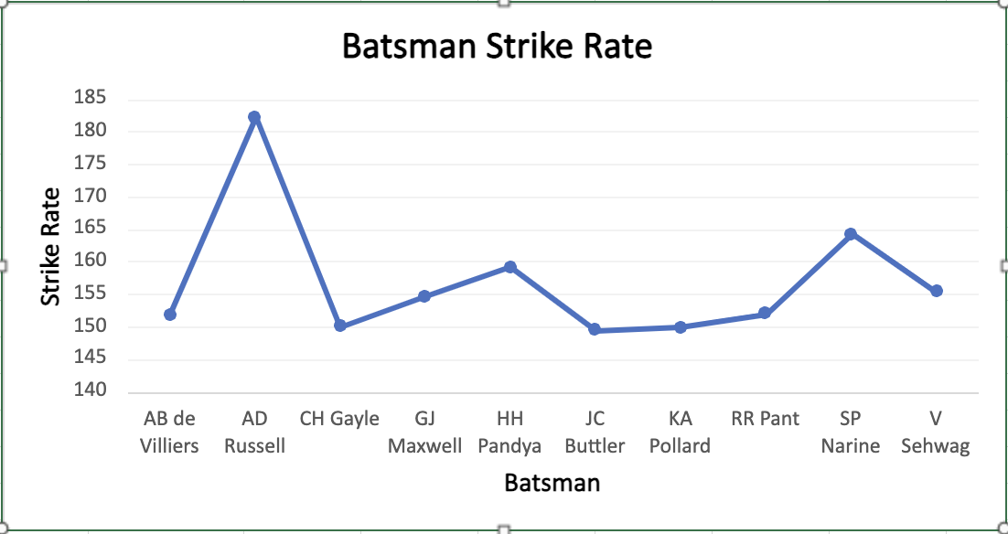
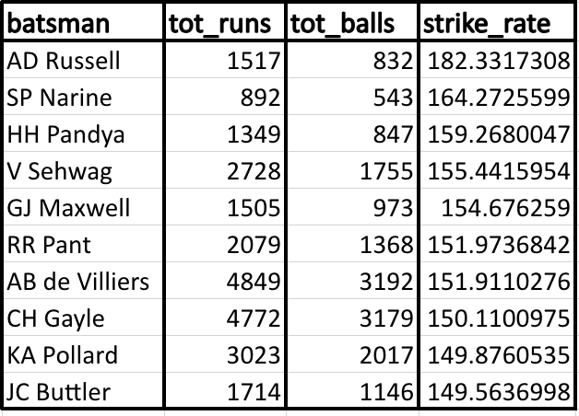
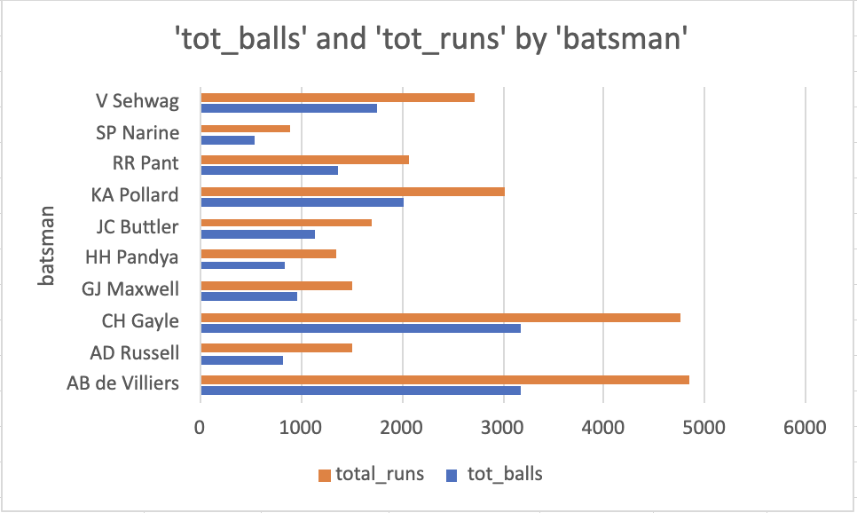
Aggressive Batters

Slide 3
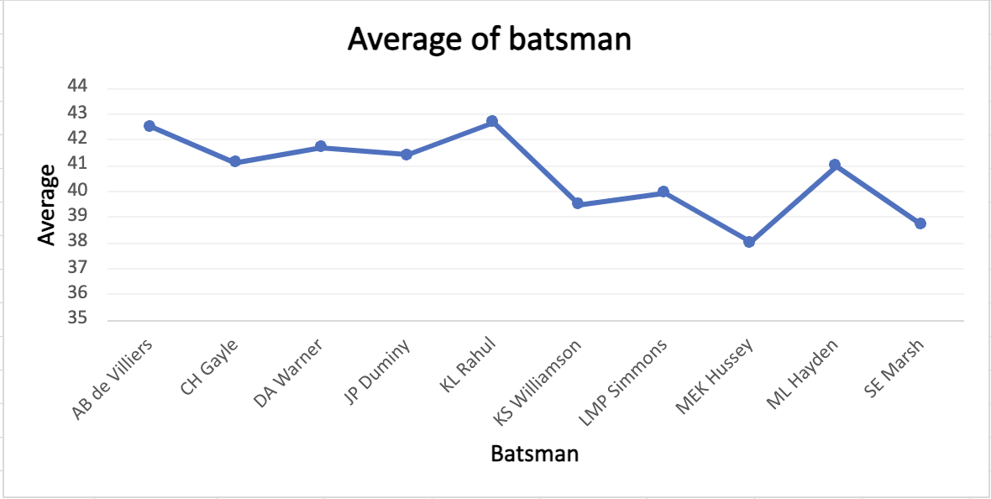
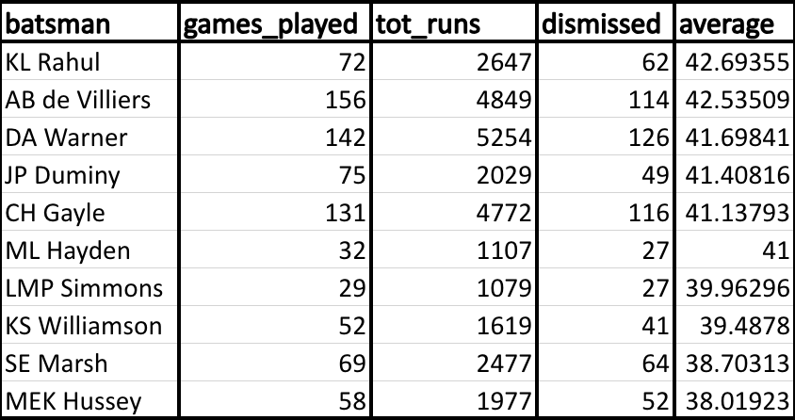
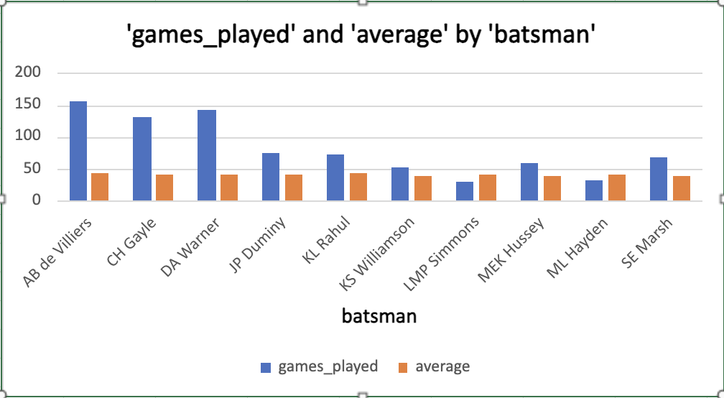
Anchor batters

Slide 4
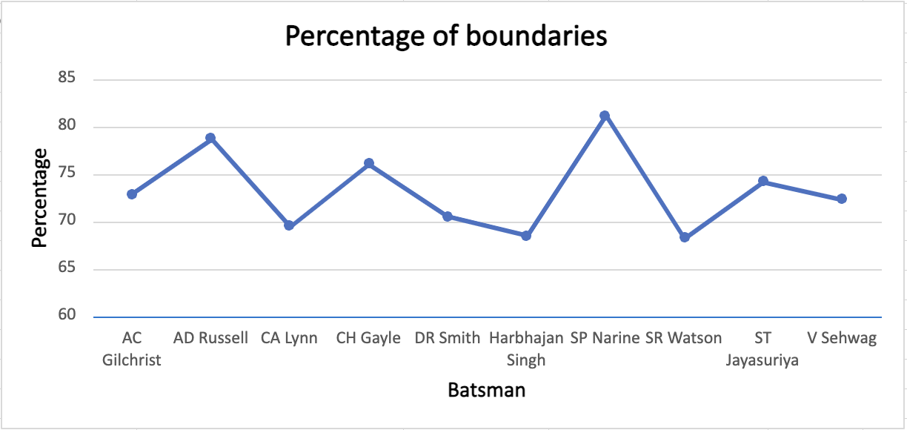
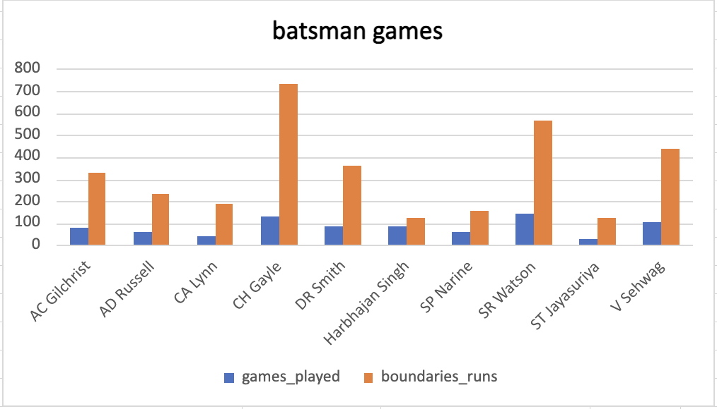
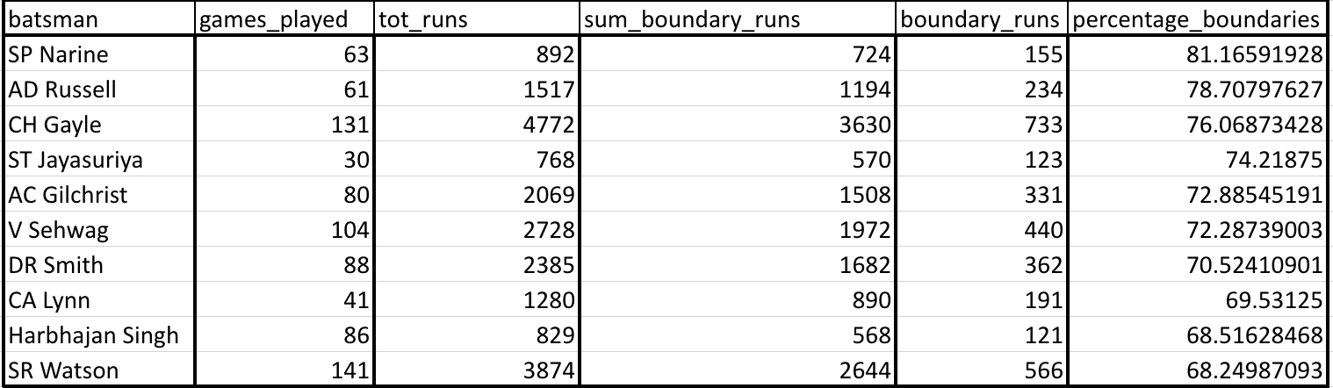
Hard Hitters

Slide 5
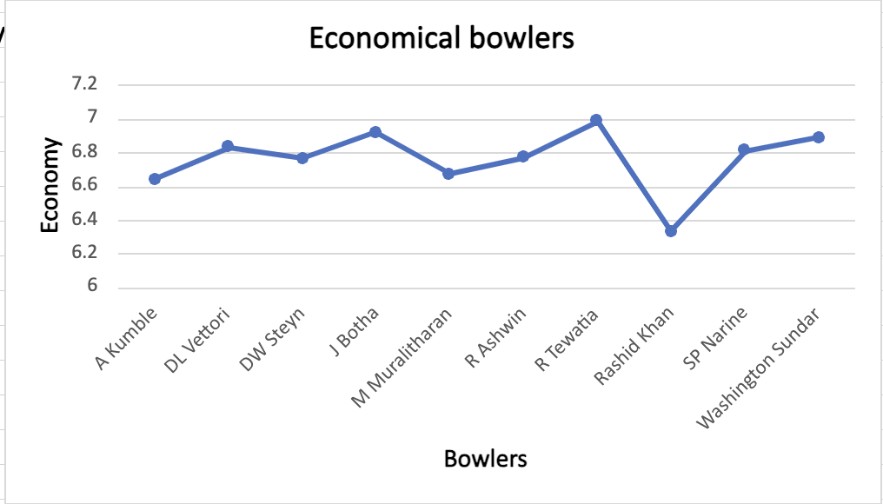
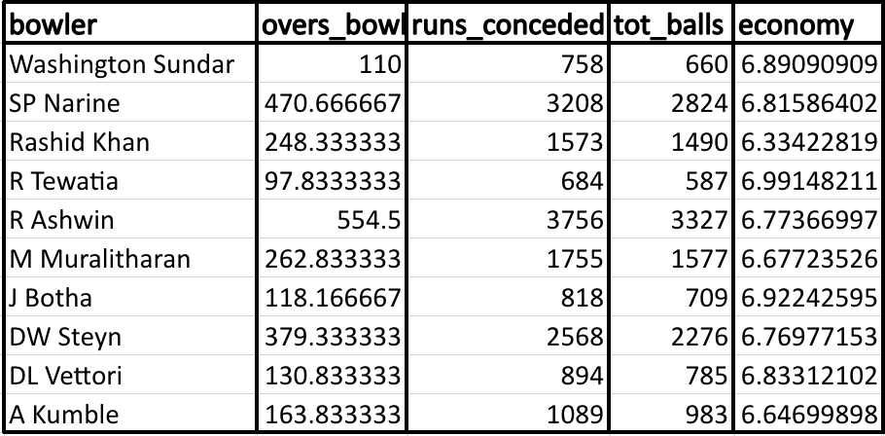
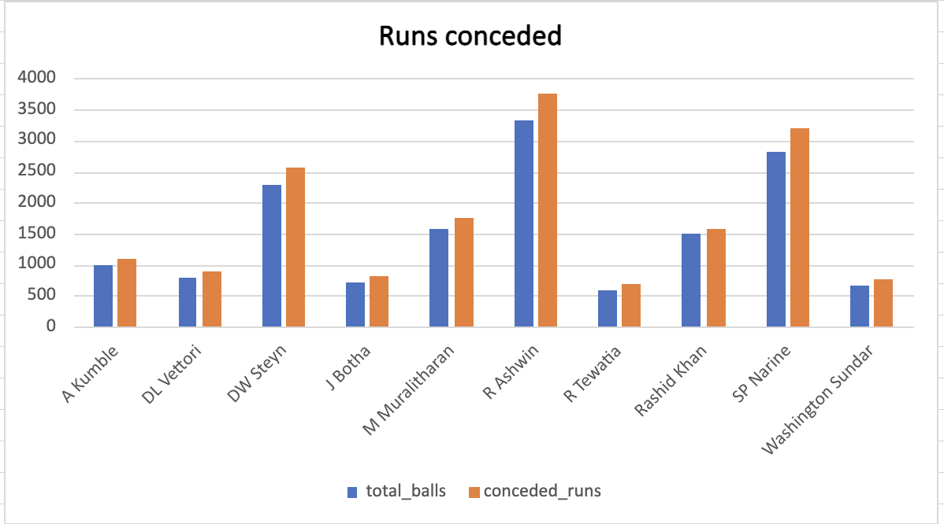
Economical Bowlers

Slide 6
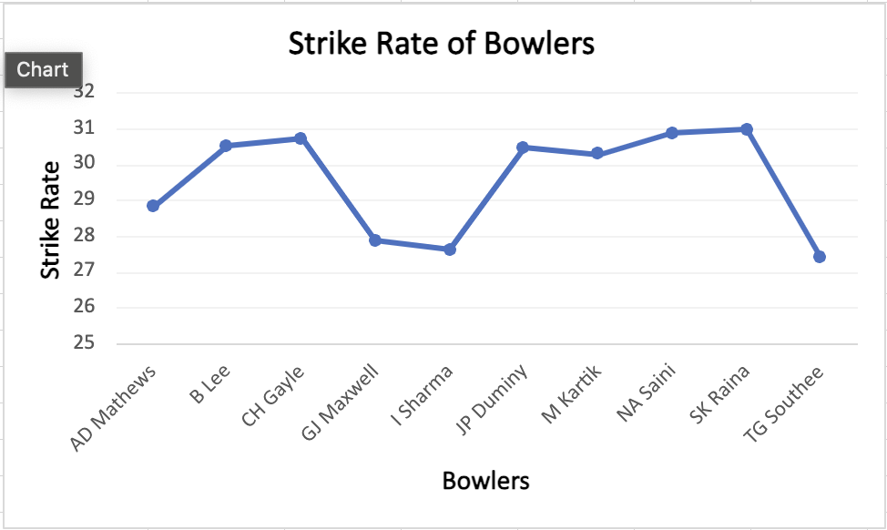
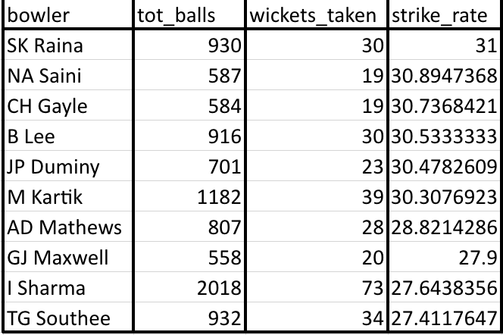
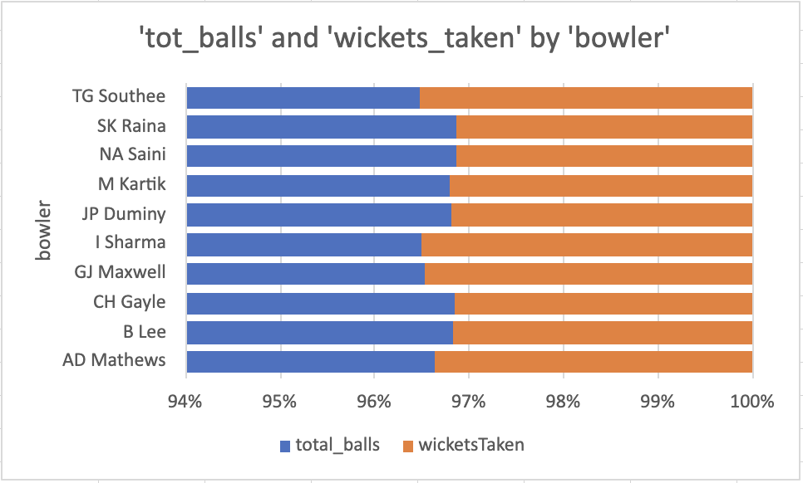
Wicket Taking Bowlers

Slide 7
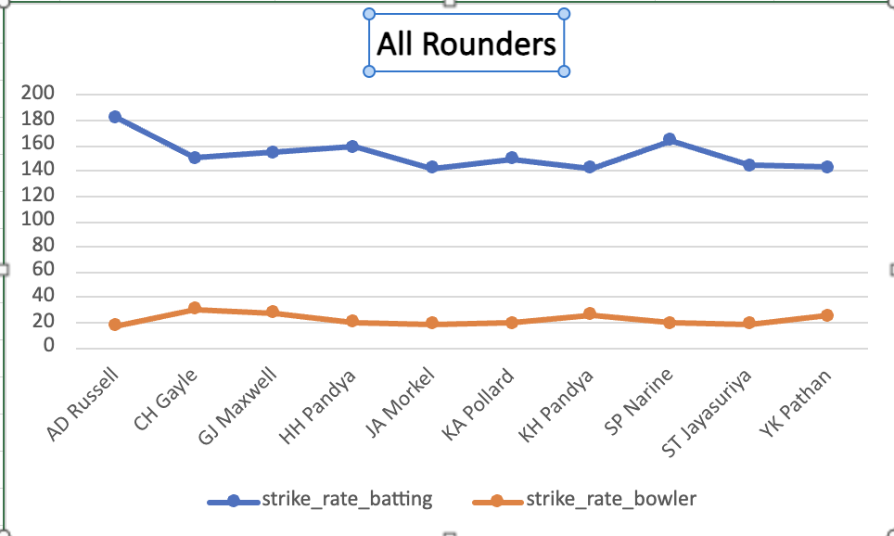
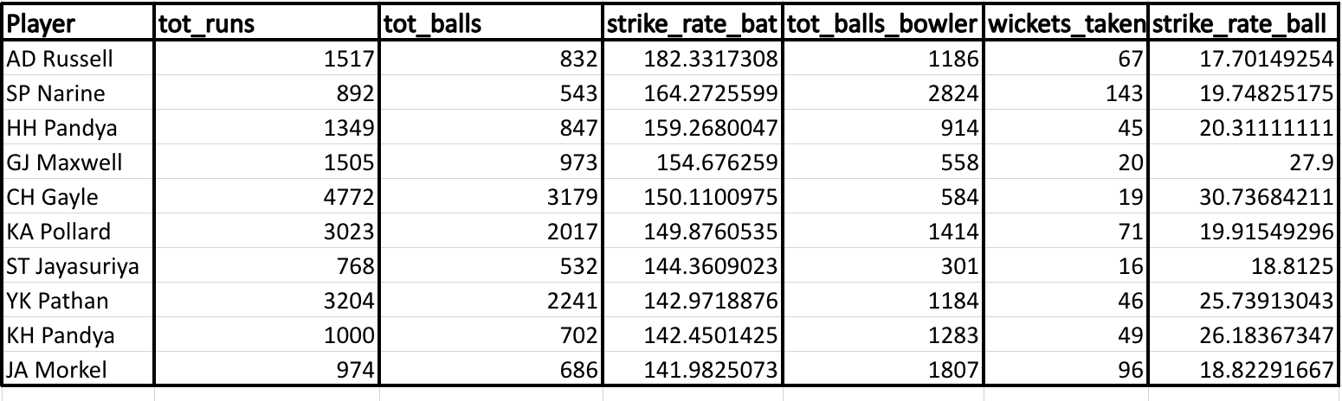
All Rounders

Slide 8

Wicket Keeper
Keeping Skills: The primary responsibility of a wicketkeeper is to be proficient in keeping wickets. This includes skills such as catching, stumping, and overall agility behind the stumps. The ability to move quickly and react to deliveries is crucial.
While the wicketkeeper's primary role is to excel as a keeper, their batting skills are also taken into account. A wicketkeeper who can contribute runs with the bat adds value to the team. Batting average, strike rate, and the ability to handle different match situations are important metrics.
So for query we need to make sure player have good avg in batting, high strike rate, played at least 3 seasons.

Slide 9


SQL Queries

Slide 10
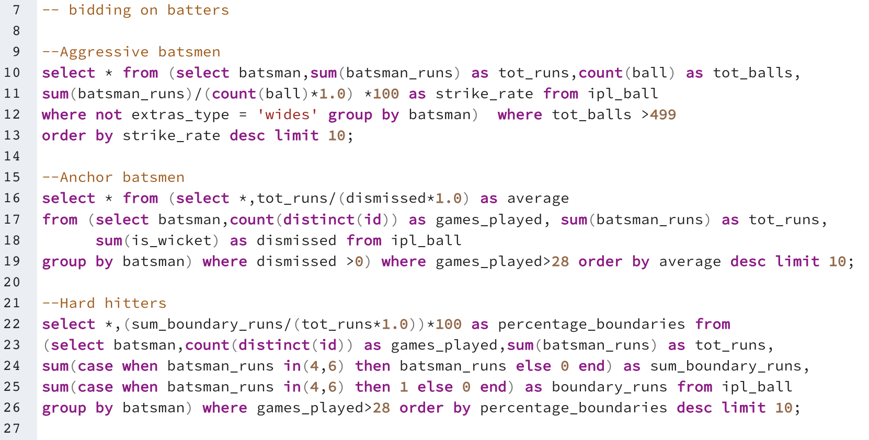
SQL Queries

Slide 11
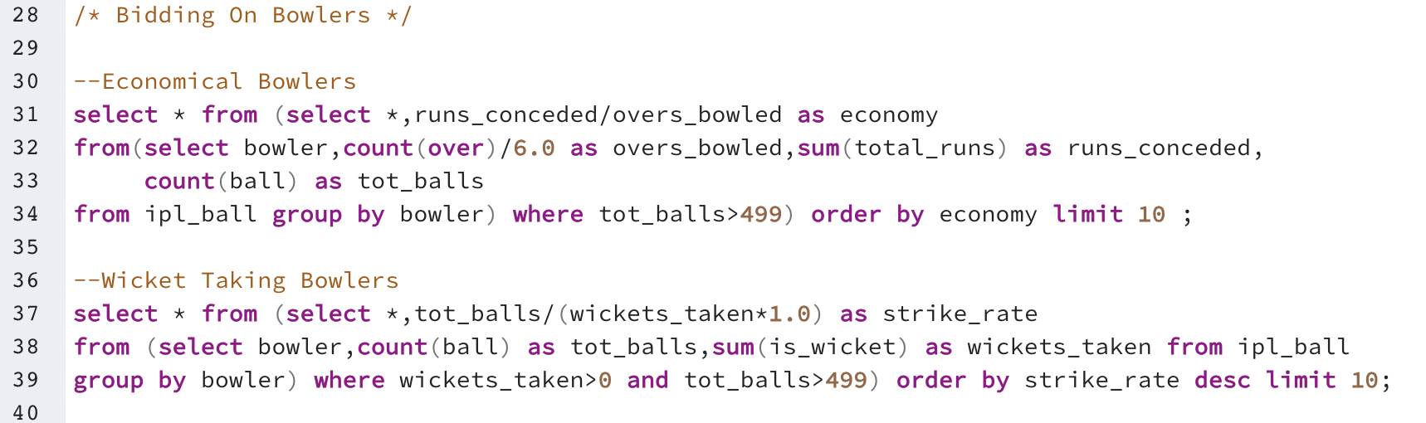
SQL Queries

Slide 12
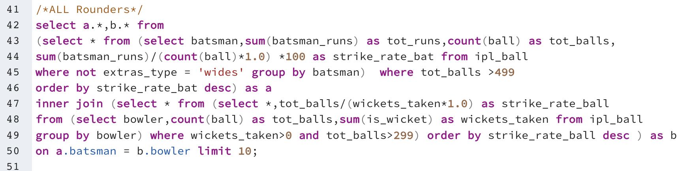
SQL Queries

Slide 13
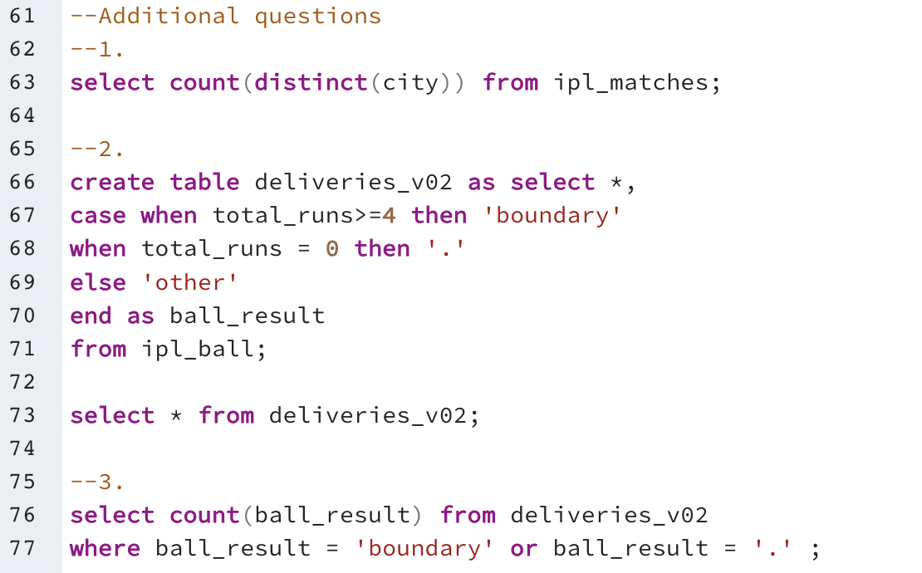
SQL Queries

Slide 14
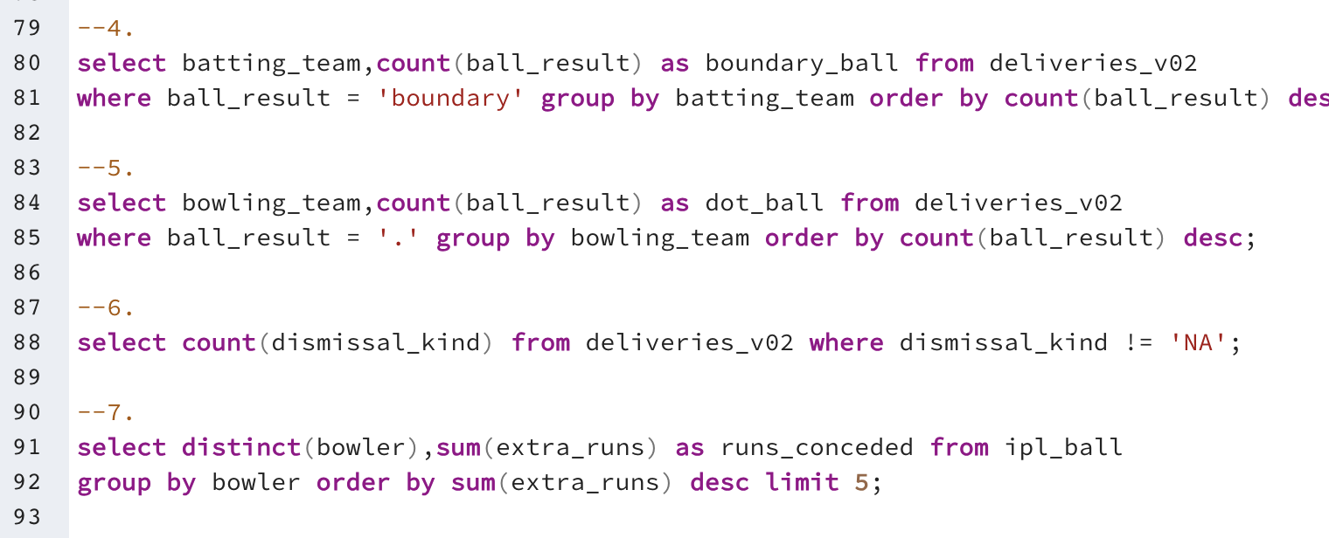
SQL Queries

Slide 15
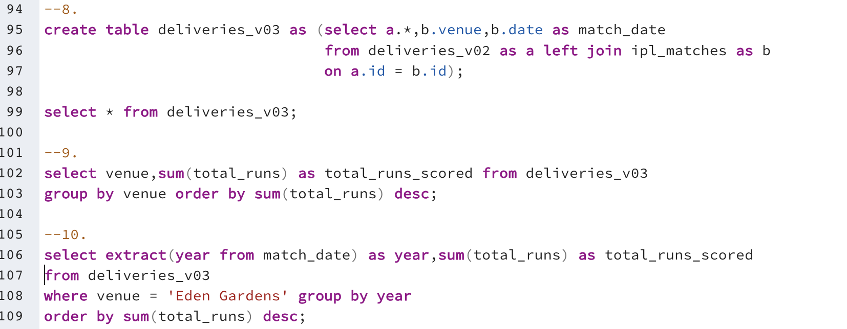
SQL Queries

